Slide 1
DEPRESSION HANDLING SKILL FOR AMAZON ALEXA

Slide 2
1.Clarity of the project:
What is amazon alexa?
Alexa (named after the ancient library of Alexandria) is Amazon’s voice control system. It lets you speak your wishes and see them fulfilled—at least simple ones, like dimming your lights or playing music tracks. It turns the Echo, Dot, and Tap streaming audio players into de facto smart-home hubs and Internet assistants. And it’s what turned Echo into not just one of this year’s biggest tech products, but possibly the biggest news so far for those interested in smart-home control.

Slide 3
Alexa, the voice service that powers Echo, provides capabilities, or skills, that enable customers to interact with devices in a more intuitive way using voice.
Amazon Echo:
Amazon Echo is a hands-free speaker you control with your voice. Echo connects to the Alexa Voice Service to play music, make calls, send and receive messages, provide information, news, sports scores, weather, and more—instantly. All you have to do is ask.

Slide 4
Some tasks performed by alexa:
•Plays all your music from Amazon Music, Spotify, Pandora, iHeartRadio, TuneIn, and more using just your voice
Answers questions, reads the news, reports traffic and weather, reads audiobooks from Audible, gives info on local businesses, provides sports scores and schedules, controls Amazon Video on Fire TV, and more using the Alexa Voice Service
•Controls lights, fans, TVs, switches, thermostats, garage doors, sprinklers, locks, and more with compatible connected devices from WeMo, Philips Hue, Sony, Samsung SmartThings, Nest, and others

Slide 5
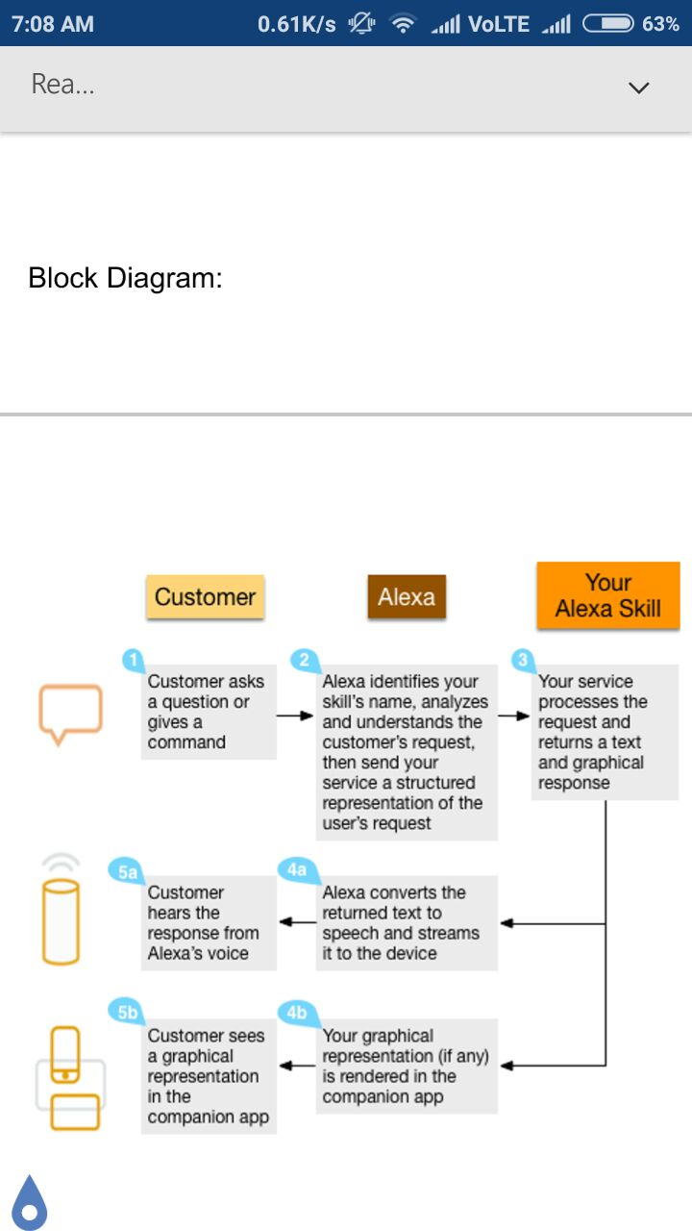

Slide 6
Alexa skills:
What’s a skill? In the Echo/Alexa world, a skill is like an app. It’s a little program you can add to your Echo/Dot/Tap to enable some new, well, skills. At the time of this writing there were about 8,000 skills in the skill menu of the Alexa app, with more launching every week. In early April Amazon released the Alexa Skill Kit to the public, making it easy for anyone with basic programming chops to create skills and add them to Alexa. Once you add a skill to your Alexa account, it will work with all the Alexa devices in your home. You don’t need to add the skill to each device separately.

